Slide 1

AH Punjab Reporting
Modernizing Punjab's Animal Husbandry Department through secure Progressive Web Application technology
Team 404 | September 29, 2025

Slide 2


Communication: Slack channel for daily updates + weekly Zoom meetings
Task Assignment: GitHub Issues for tracking development tasks and bugs
Version Control: GitHub with feature branching
Support: 10–15-minute weekly updates where everyone shares progress
Meet Team 404
Arshpreet Singh Sidhu
Divanshu Arora
Project Lead & Backend Architect
Backend Development
Database schema, DevOps, Docker deployment, security protocols
Fastify APIs, JWT authentication, data encryption, unit testing
Gurleen Kaur Brar
Frontend Analytics
React dashboards, analytics, integration testing, version control
Khushmandeep Kaur
Manpreet Kaur
Frontend Workflows
Frontend Development
Report forms, submission workflows, user testing coordination
React components, UI implementation, responsive design
Fatma Ahmed
UI/UX Design
Figma prototypes, accessibility, user documentation

Slide 3


The Critical Problem
Current System Failures
Google Sheets as database causing 900-2000ms delays
Plaintext API requests with zero security
Android-only access limiting reach
No draft saving or offline capability
Serving 1000+ veterinary institutes across 22 districts with a system that's fundamentally broken at scale.

Slide 4

Our Solution: Modern PWA Architecture
Secure Authentication
Real Database
Cross-Platform Access
JWT tokens + WebAuthn biometric login replacing insecure SharedPrefs storage
PostgreSQL with proper indexing and caching, eliminating Google Sheets bottlenecks
PWA technology works on any device - Android, iOS, desktop, tablets

Slide 5



Target Market Impact
HQ Administrators
1
20+ users managing policy
District Supervisors
2
100+ users overseeing regions
Field Veterinary Staff
3
500+ daily users submitting reports
Transforming workflows across 22 districts, 150+ tehsils, and 1000+ veterinary institutes throughout Punjab.

Slide 6




Our Competitive Edge
vs Current System
Real SQL database, enterprise security, cross-platform PWA, offline-first design
vs Generic Solutions
Specialized veterinary workflows, built-in approval hierarchy, inventory tracking integration
vs Commercial Platforms
Cost-effective open source, Punjab-specific customization, local hosting, no vendor lock-in

Slide 7
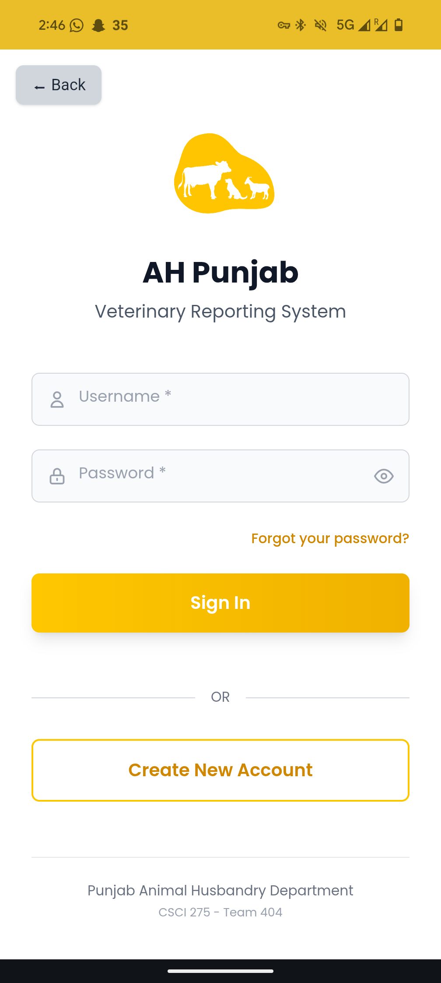
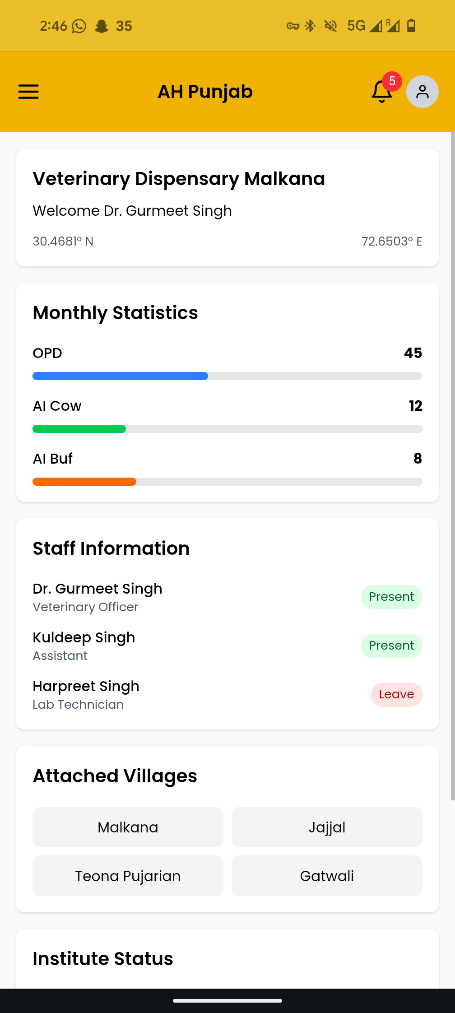
MVP Core Features
Security & Access
JWT + WebAuthn fingerprint login
Role-based permissions
Encrypted data transmission
Reporting Workflows
Digital form submission
Draft saving with auto-save
Analytics & Management
Performance dashboards
PDF report generation

Slide 8




Technology Stack
Frontend
Backend
React 18, Vite, Tailwind CSS with PWA service workers and IndexedDB for offline capability
Fastify Node.js, PostgreSQL, Redis caching with JSON Schema validation
Security
DevOps
JWT authentication, WebAuthn biometric, Argon2id hashing, TLS encryption
Docker containers, Nginx proxy, GitHub, Cloudflare protection

Slide 9

6-Week Sprint Timeline
Sprint 1: Foundation
1
Database schema, Fastify backend, React PWA setup. Deliverable: Working dev environment
2
Sprint 2: Authentication
JWT + WebAuthn, role-based access, user management. Deliverable: Secure login system
Sprint 3: Core Reports
3
Report forms, PostgreSQL APIs, validation. Deliverable: Report submission functionality
4
Sprint 4: Enhancement
Draft saving, approval workflows, dashboards. Deliverable: Complete user experience
Sprint 5: Production
5
User testing, deployment, documentation. Deliverable: Production-ready application

Slide 10

Delivering A Digital Future
<200ms
99.5%
1000+
Response Time
Uptime Target
Institutes Served
10x faster than current system
Enterprise-grade reliability
Across all 22 districts
Team 404 is ready to transform Punjab's veterinary reporting with modern, secure, and scalable technology. Let's revolutionize animal husbandry reporting together.

Slide 11

Thank You
Any Questions?

